Slide 1
Automatic LLM Refactor
Automatically detect design smells, refactor code, and raise GitHub PRs
Presented by: Abhishek Kumar

Slide 2
Project Goal
Automate the process of code quality improvement
Detect design/code smells in Java code using LLMs
Perform AI-driven refactoring
Push changes via automated Pull Requests on GitHub

Slide 3
Objectives
Analyze Java files for design/code smells
Use LLMs to generate improved versions of code
Apply changes to the repository programmatically
Raise a pull request with a detailed summary of improvements

Slide 4
Technologies Used
GitHub Actions – CI/CD for automation
Python – Scripting the core logic
Google Generative AI (Gemini) – For code analysis and refactoring
OpenAI (Optional) – Alternative LLM integration
PyGithub – GitHub API integration
GitHub Secrets – Secure environment variable management

Slide 5
Key Features
Detects Cyclomatic Complexity, Method Length, Class Coupling
Counts Lines of Code and Number of Parameters
Uses Gemini LLM to suggest improvements
Auto-commits refactored code in a new branch
Opens a Pull Request with a summary of issues and fixes

Slide 6
Workflow Architecture
GitHub Action Trigger → Python Script Execution
Select .java files → Analyze via LLM
Generate refactored code → Commit and Create PR

Slide 7
How It Works (Implementation)
pick_files() – Selects random Java files
refactor_file() – Gets design smell report and refactored code from LLM
apply_refactorings_to_files() – Commits changes
create_pull_request() – Opens PR with summaries

Slide 8
Output & Results
Design Smells Report generated
Refactored Java code created
Pull Request raised automatically with detailed summary

Slide 9
Benefits
Saves manual code review time
Promotes cleaner, maintainable code
Ideal for legacy codebases and large teams
Extensible to other programming languages supported by LLMs

Slide 10
Future Enhancements
Support for other languages (Python, JS)
Use LLM for unit test generation
Integration with CI gates
Interactive approval of refactorings
Integration with GitHub Copilot Labs or VS Code

Slide 11
Learnings
Learned GitHub Actions, PyGithub, and LLM APIs
Gained deeper understanding of code quality metrics
Automated developer workflows using LLMs
Real-world application of AI in software engineering

Slide 12
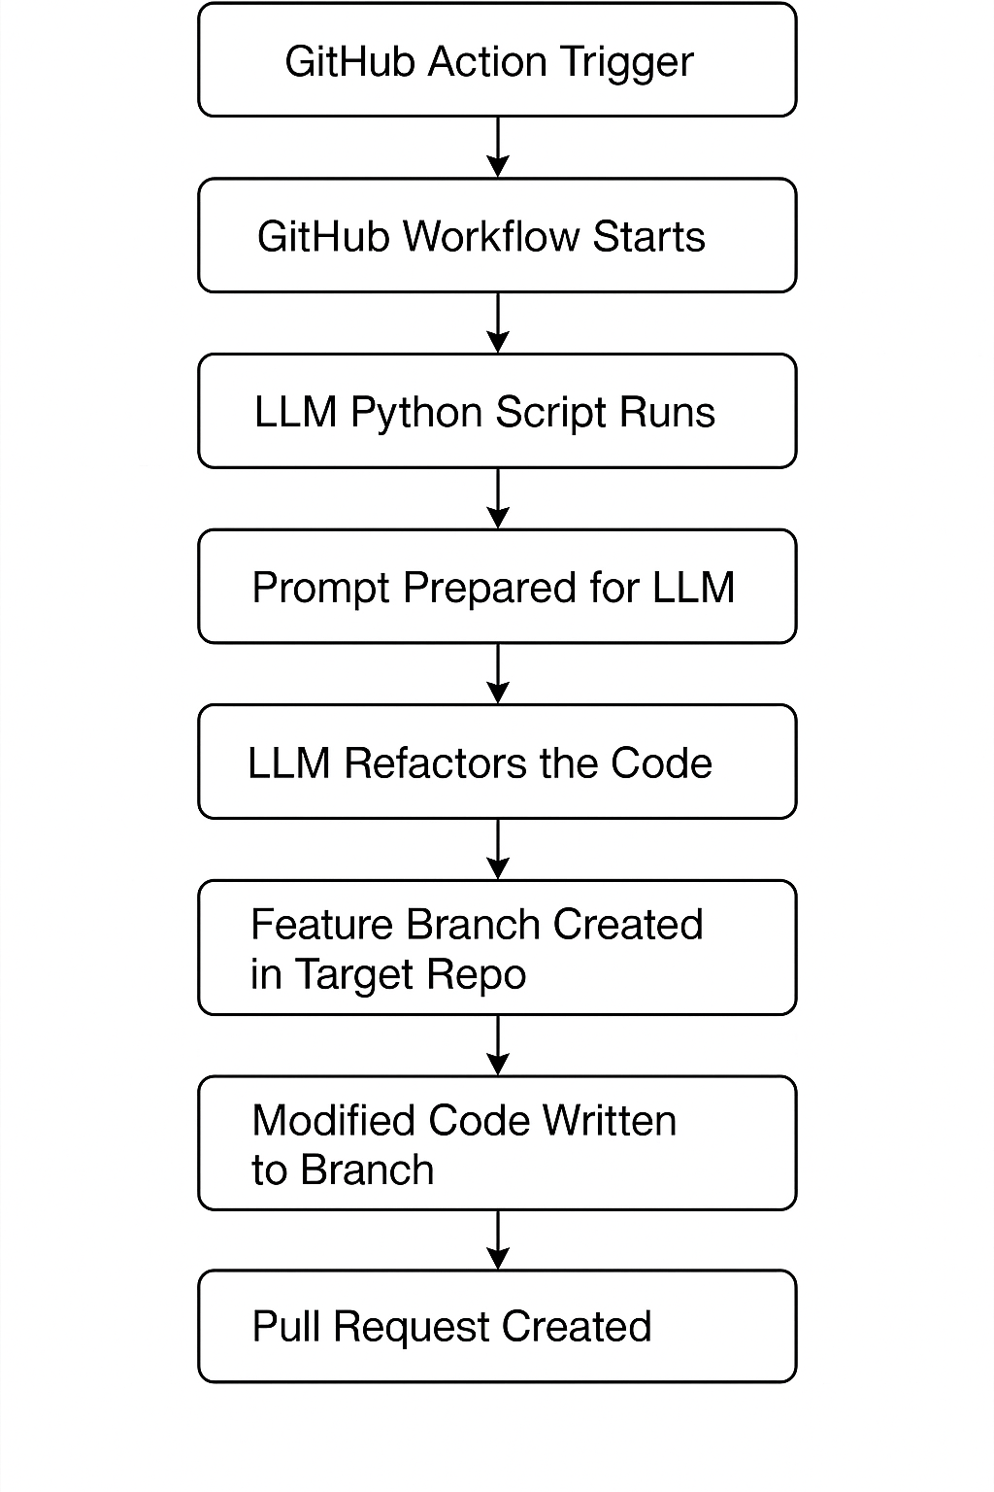
High-Level Design (HLD)

Slide 13
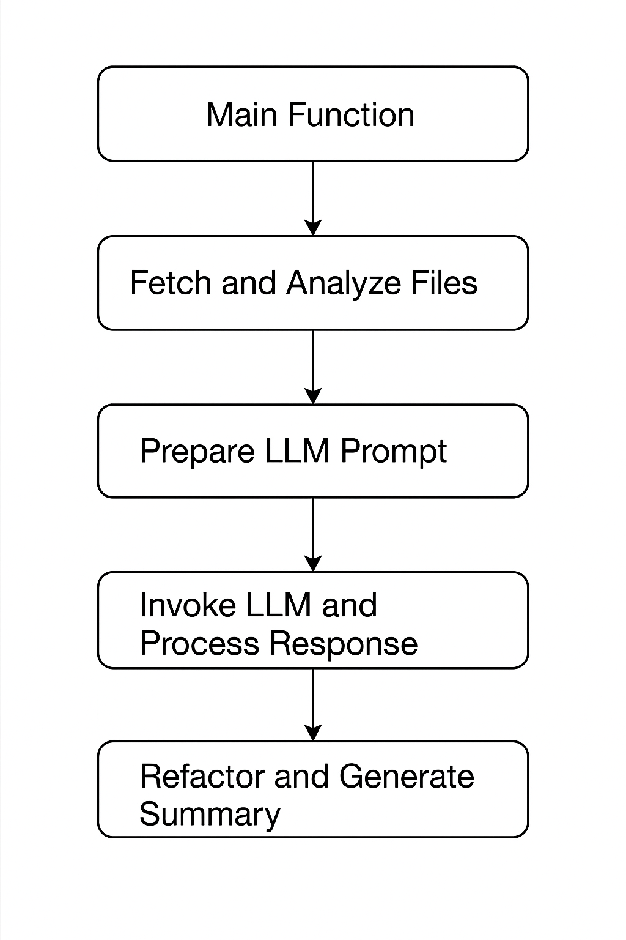
Low-Level Design (LLD)

Slide 14
Thank You
Questions?

